Slide 1
Focus Questions: 9/22/14
What does each of the following tools measure:
Graduated cylinder
Balance
Ruler
What is the base unit for:
mass
volume
length

Slide 2
Scientific Notation
A method of writing very large or very small numbers in powers of 10.
General rule- M x 10^{n}
M should not be a number greater than 9
n can be negative if the original number is less than 1
n can be positive if the original number is greater than 1

Slide 3
Practice!
Complete Scientific Notation Worksheet
10 minutes

Slide 4
By the end of today you will:
Be able to analyze the structure and components of an atom as well as identify the nuclear symbol, atomic mass and number of elements on the periodic table

Slide 5
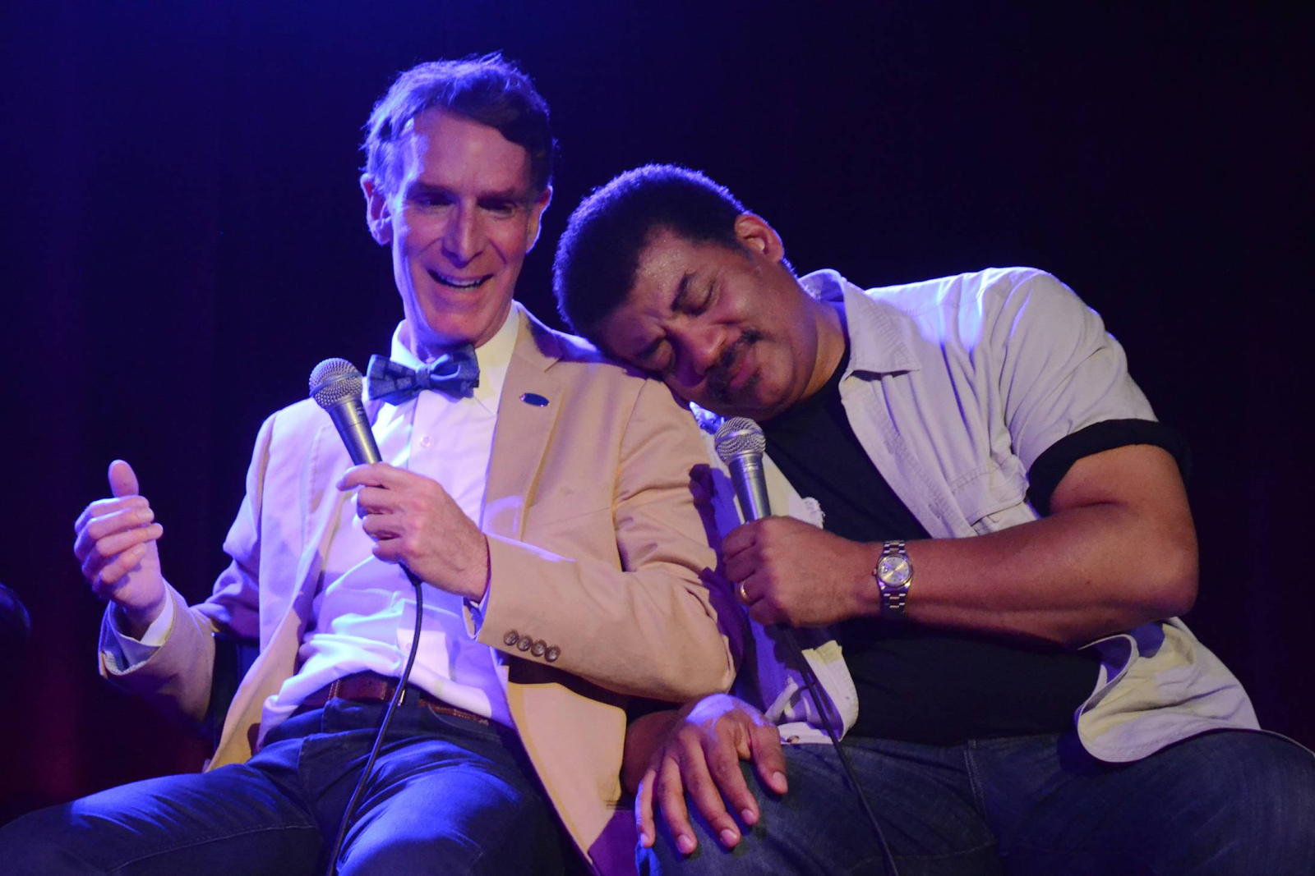
Bill Nye the Science Guy!
Watch video and complete notes as follows. Notes will be glued onto the right hand side of your notes!
Watch Here!

Slide 6
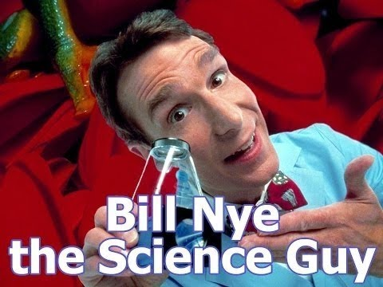
Questions?

Slide 7
Flex and Finess your Knowledge!
Draw a number from the container.
This number = atom you will create!
You must have: Correct number of proton, neutrons, and electrons

Slide 8
Important Vocab and What does it Mean?
Nuclear Symbol- Has 3 parts: the symbol of the element, the atomic number of the element and the mass number of the specific isotope.

Slide 9
Atomic Number: The subscript of the nuclear symbol. It tells you the number of protons in the nucleus of the atom.
Atomic Mass: The superscript of the nuclear symbol. It tells you the number of protons and neutrons in the nucleus of the atom.

Slide 10
Practice!
Complete worksheet (this is a left hand side item!)
15 minutes

