Slide 1
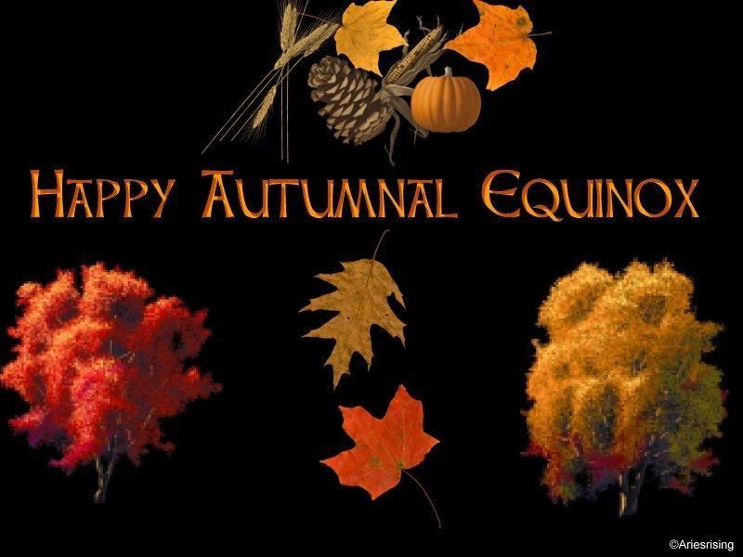
Focus Questions: 9/23/14
Name what a balance is used to measure and its correct base unit
What is the atomic number of uranium? How many electrons does it have?
How many neutrons are in carbon if the atomic mass is 12?
How many neutrons are in carbon if the atomic mass is 13?

Slide 2
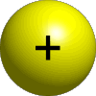
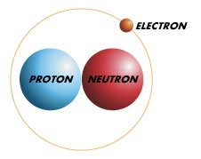
Subatomic Particles
Protons
Neutrons
Electrons

Slide 3
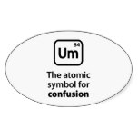
Atomic Symbol
Must have elemental symbol and mass number
Ex:
C-12 or ²² Ne
This tells you the isotope

Slide 4
Practice!
Complete Chart on Back Side of Worksheet
15 minutes

Slide 5
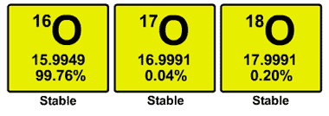
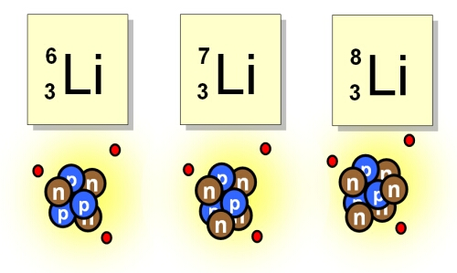
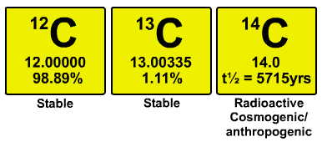
Isotopes
The different possible versions of an element

Slide 6
Ions - Elements with Charges
charge → MORE PROTONS than electrons
charge → MORE ELECTRONS than protons
Mg⁺² = 12 p
10 e
O ⁻² = 8 p
10 e

Slide 7
Practice!
Atomic Structure Worksheet
15 minutes

Slide 8
Calculating Atomic Mass
Mass # x % abundance = Isotope #1
Mass # x % abundance = Isotope #2
+ __________
Atomic Mass

Slide 9
Practice!
As class, practice #1
Individually, complete rest of sheet

